Slide 1

Bayesian Statistics in R: a whistle-stop tour
Lindsay F Banin
CEH Statistics & R Conference, 23rd-24th November 2016

Slide 2
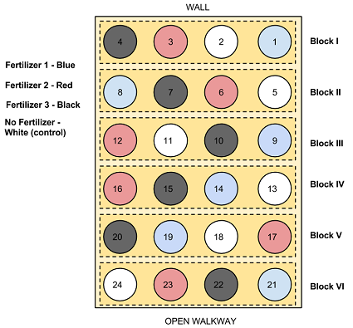
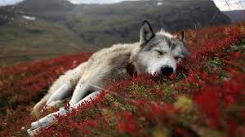
Why be a Bayesian ecologist/environmental scientist?
Combining data from different sources, indirect information (e.g. primary data, prior knowledge)
Data collected at different scales, sampling methods
Modelling temporal/spatial dependence
Forecasting, projecting uncertainty
Identifying thresholds

Slide 3

Drawing inference
z|g (θ_{p}, x), σ²_{p}
Sampling and measurement error
Probability distributions for each parameter - priors
Hobbs & Hooten 2015
Notes:
True state ‘z’ modelled by deterministic function g for predictor variables x and parameters theta. Parameter sigma squared accounts for unaccounted variables, treating them as stochastic.

Slide 4

Applying a Bayesian approach
Directed acyclic graphs (DAGs)
Gibbs samplers, e.g. JAGS/BUGS
Multi-model inference/comparison
Hobbs & Hooten 2015

Slide 5
Applying a Bayesian approach
Directed acyclic graphs (DAGs)
Gibbs samplers, e.g. JAGS/BUGS
Multi-model inference/comparison
Hobbs & Hooten 2015

Slide 6
Parameters are random
Rather than estimating FIXED parameters, in a Bayesian setting parameters are random so you predict a distribution of likelihood for the true parameter
Data X are observations from a random process
Parameters θ are random quantities of that process
Joint distribution of all these random quantities – P(X, θ)
Notes:
Add why this property is useful

Slide 7
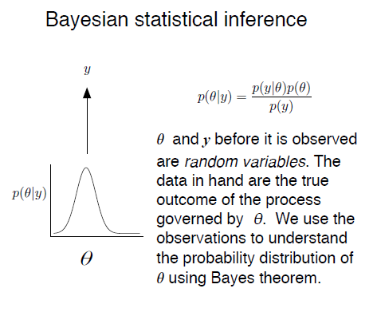

Slide 8
All unobserved quantities are treated the same way:
Model parameters
Missing data
Predictions/forecasts
Latent states
Data (before they are observed)

Slide 9
Bayes’ Theorem
POSTERIOR DISTRIBUTION
Of θ given data
P(θ | X) = P(X | θ) P(θ)/P(X)
LIKELIHOOD OF DATA given θ
MARGINAL DISTRIBUTION
Of data X
PRIOR DISTRIBUTION
For θ

Slide 10
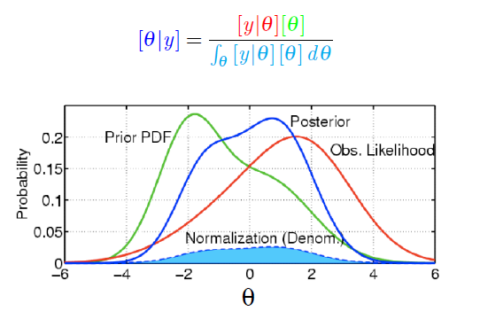
Bayes’ Theorem
POSTERIOR DISTRIBUTION
Of θ given data
P(θ | X) = P(X | θ) P(θ)/P(X)
LIKELIHOOD OF DATA given θ
MARGINAL DISTRIBUTION
Of data X
PRIOR DISTRIBUTION
For θ

Slide 11
Prior information
Informative priors – expert opinion; previous studies; intervals; expressions of uncertainty
Proper priors (i.e. area under curve integrates to 1)
Vague priors (a.k.a. flat, diffuse; at the beginning of your analysis, plot your priors to check they make sense and genuinely are vague)
Shape of prior becomes less influential and likelihood more influential with increasing sample size
Conjugacy – allows more straight forward solution
Support – what values are logical given the nature of the data?

Slide 12
Posterior distribution
Notes:
We can see what it is in principle but how do we estimate a probability distribution for something unknown?

Slide 13
Sample based estimation
Numerical methods to approximate the posterior distribution, avoiding the need to integrate the marginal distribution
Algorithms to sample the unknown quantities from the posterior
Inference drawn from summarising histogram
Markov chain Monte Carlo sampling (MCMC)
If we know the full conditional distribution (i.e. conjugate distributions) we can use a Gibbs sampler; if not use an accept/reject sampler e.g. Metropolis-Hastings
MCMC uses likelihood profile and priors to generate many random samples, proportionate to their density
Notes:
Different strengths – JAGS not so good for spatial data, but more flexible and don’t need to point-and-click using GUI and better for collaboration as also works on mac and Linux systems

Slide 14
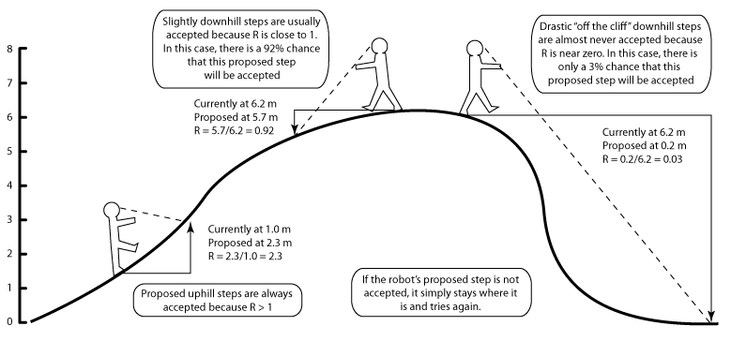
http://mcmcrobot.org/

Slide 15
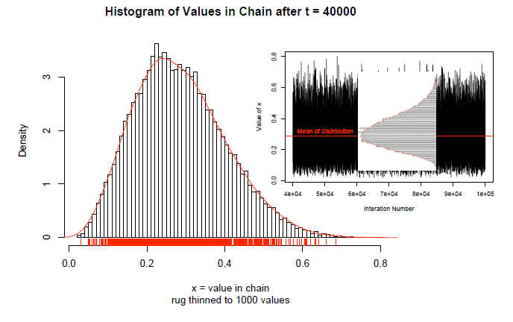
What do we get?

Slide 16
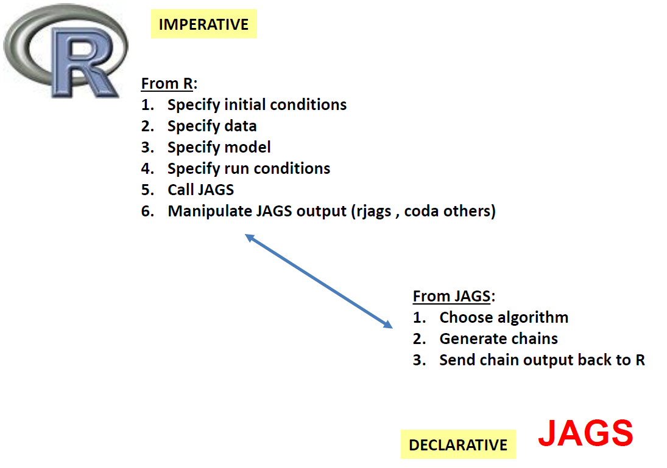
R & JAGS
(Just another Gibbs Sampler)
Notes:
How do we get it? Generate own sampler or BUGS language (Bayesian Analysis Using Gibbs Sampler) E.g. OpenBUGS, WinBUGS, JAGS
Different strengths – JAGS not so good for spatial data, but more flexible and don’t need to point-and-click using GUI and better for collaboration as also works on mac and Linux systems

Slide 17
Model specification
Directed acyclic graphs (DAGs)
Visualising the problem and communicating with statisticians
Notes:
First step of course is to plan the model – treated trivially here although in reality, should be one of the biggest investments of your time.

Slide 18
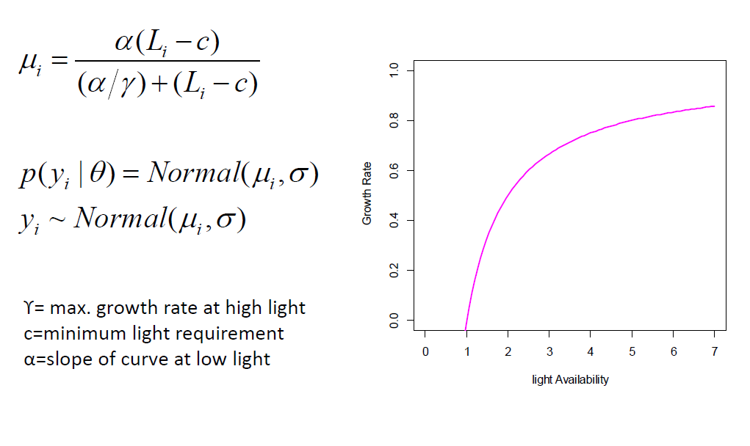
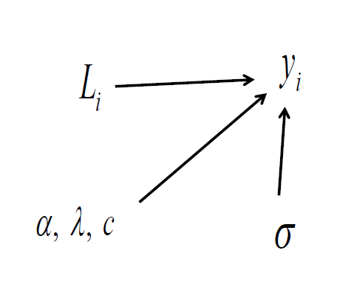
Model specification
Directed acyclic graphs (DAGs)
Visualising the problem and communicating with statisticians
Notes:
First step of course is to plan the model. What is the support for the priors; select from same family of distributions (moment matching – look up sheets are helpful!)

Slide 19
MCMC
JAGS model
We specify:
The deterministic model
The likelihoods
The priors
We choose:
Number of chains
Iterations (samples) per chain
Adaptation and burn-in

Slide 20
MCMC
JAGS model
We specify:
The deterministic model
The likelihoods
The priors
We choose:
Number of chains
Iterations (samples) per chain
Adaptation and burn-in
Coda and JAGS objects to manipulate the samples from chains

Slide 21
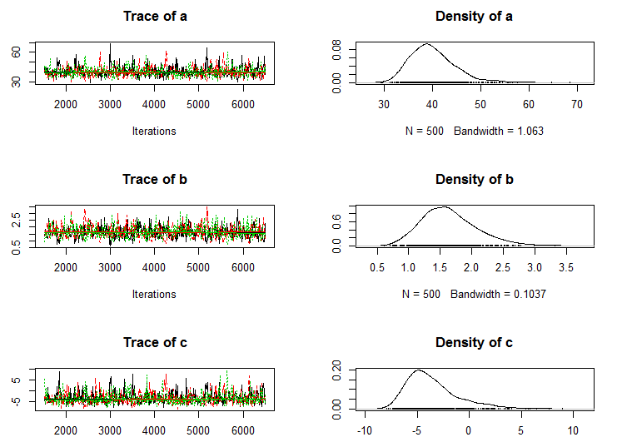
Example output
Notes:
NB thin = 10

Slide 22
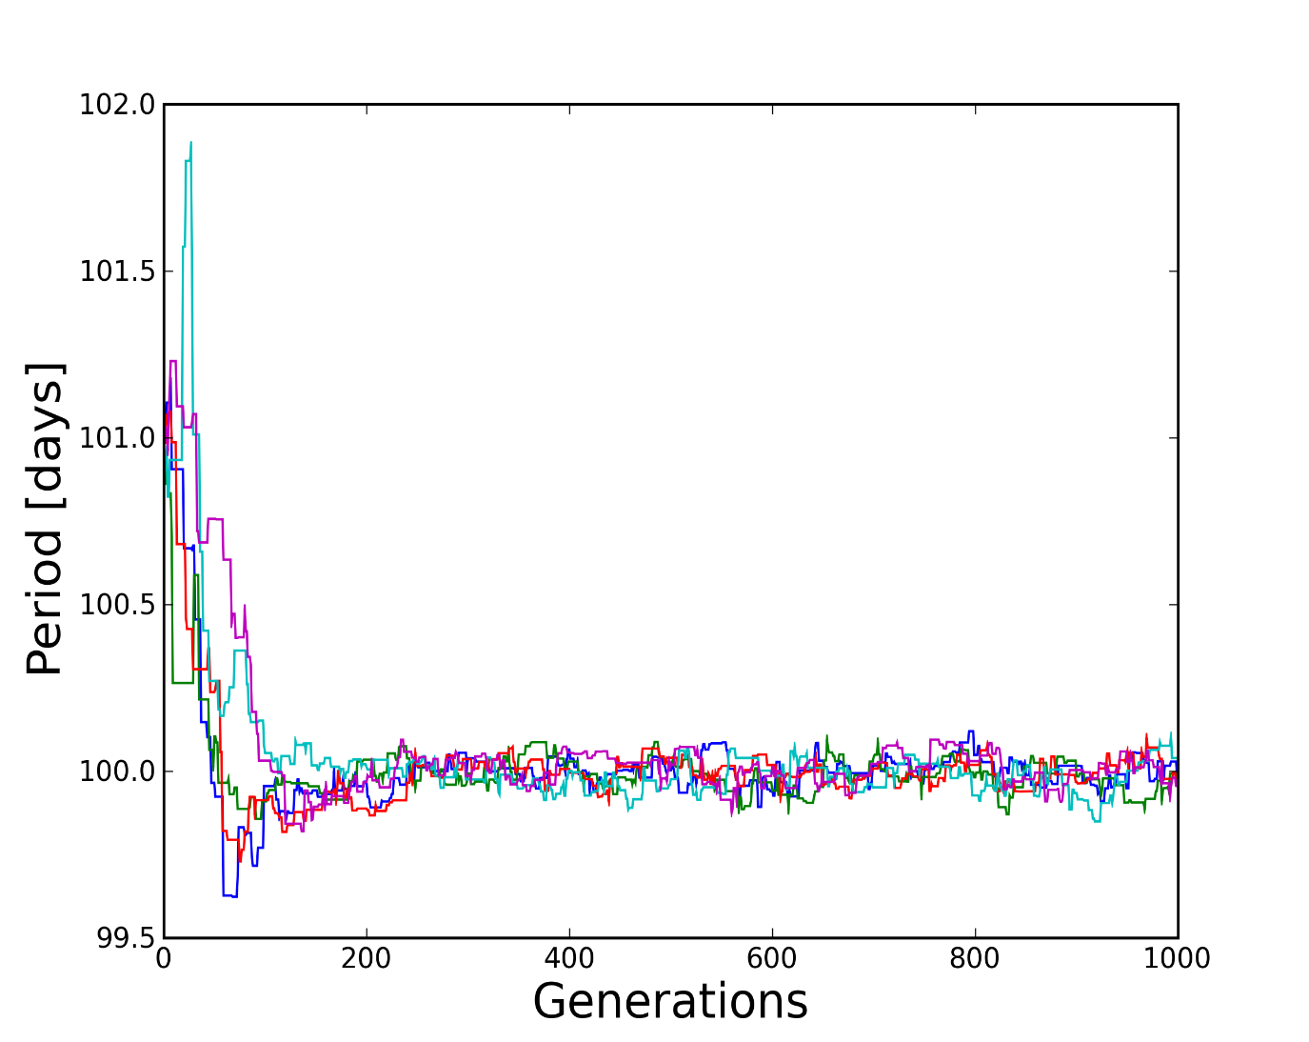
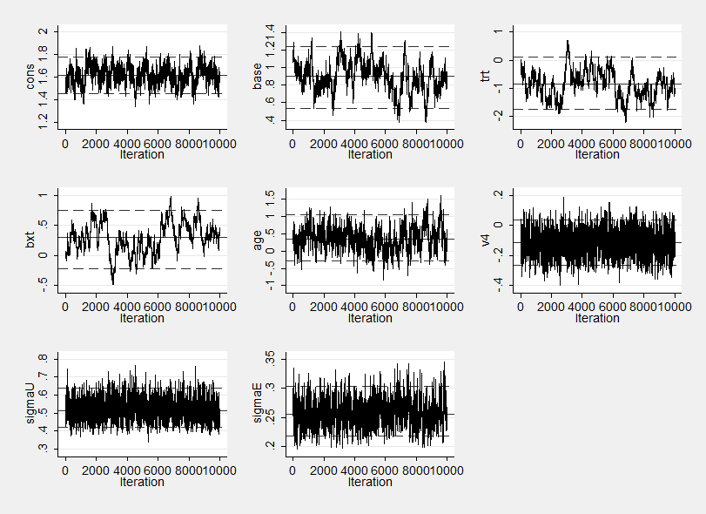
Model evaluation
Assessing convergence
Visually: mixing, burn-in
http://staffblogs.le.ac.uk/bayeswithstata/2015/02/13/
Notes:
Mixing related to autocorrelation

Slide 23
Model evaluation
Assessing convergence – i.e. adding more samples will not meaningfully change the parameter approximations
Visually: burn-in, mixing
Heidlberger and Welch diagnostic (1983) – stationarity and half width mean. Helps ascertain burn-in
Convergence statistics (e.g. Gelman-Rubin 1992) compare within vs between chain variance – i.e. outputs from chains are indistinguishable

Slide 24
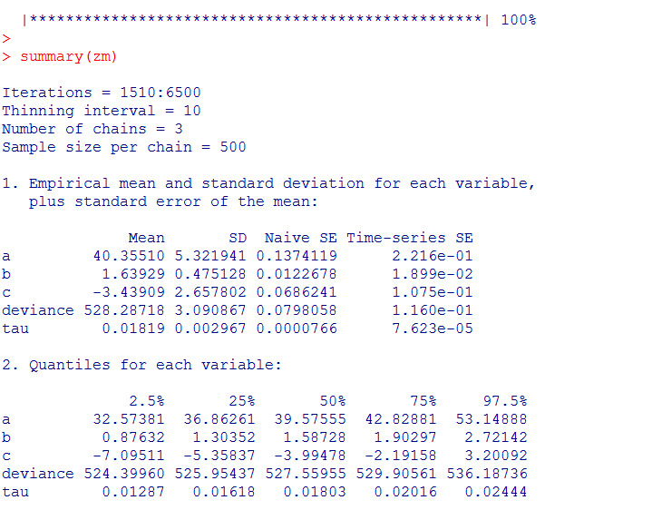
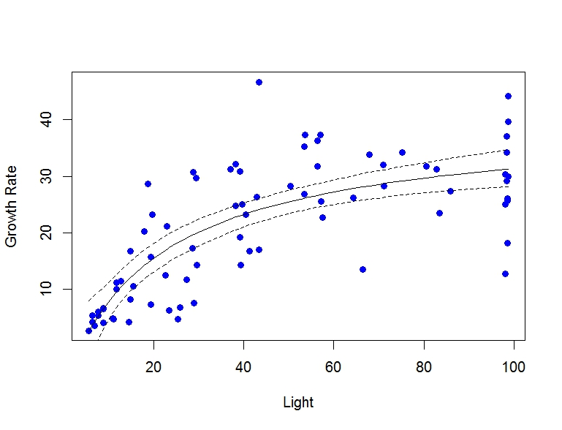
Inference
Notes:
Central tendency, credible intervals
i.e. the value of the parameter lies in that range, with a given probability (credible intervals) e.g. 95% chance a sample falls within that range

Slide 25
Posterior predictive checks
NB each prediction also has a probability distribution (posterior predictive distribution)
Observed vs predicted
Bayesian p-values
Out-of-sample prediction and validation
Multi-model inference/selection - DIC
Notes:
See day 5 PM lab

Slide 26
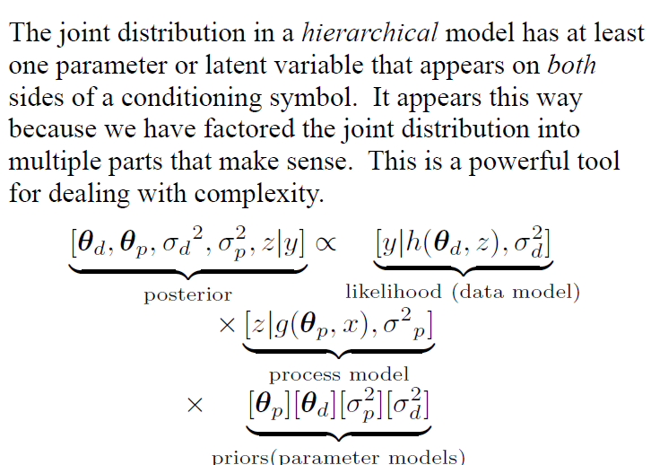
More complex models
Hierarchical models:
Group level effects
Meta-analysis
Multiple scales of space and time
Multiple sources of uncertainty
K. Ogle

Slide 27
Acknowledgements & Resources
NSF-funded course, Colorado State University: Bayesian Statistics for Practicing Ecologists
Janet Heffernan’s CEH courses: Introduction to Bayesian Statistics for Environmental Modelling; Applied Bayesian Statistics
Useful texts/resources:
Hobbs & Hooten 2015
McCarthy 2007
Ogle & Barber (2012) Bayesian statistics. In Encyclopaedia of Theoretical Ecology
http://mcmcrobot.org/

Slide 28
For tomorrow’s practical…
Check you are running a recent version of R
Install ‘rjags’ package in R
Go to http://sourceforge.net/projects/mcmc-jags/files/JAGS/. Click on Windows and then the JAGS executable (exe file).
Running multiple versions of R on your computer may cause problems!

